Slide 1
CSEE 6863 Formal Verification
Final Project
Verification of a N-Body Simulator Hardware Accelerator
Kristian Nikolov (kdn2117)
Linxiao Wu (lw3227)

Slide 2
Project Overview
N-Body Hardware Accelerator
Actual student project: Very messy code!
Mathematical correctness tested using simulation
Project seems to behave as expected, does it always?
External IP Blocks & Parameters
Required assumptions
Verifying transition between states
Discovery of Errors

Slide 3
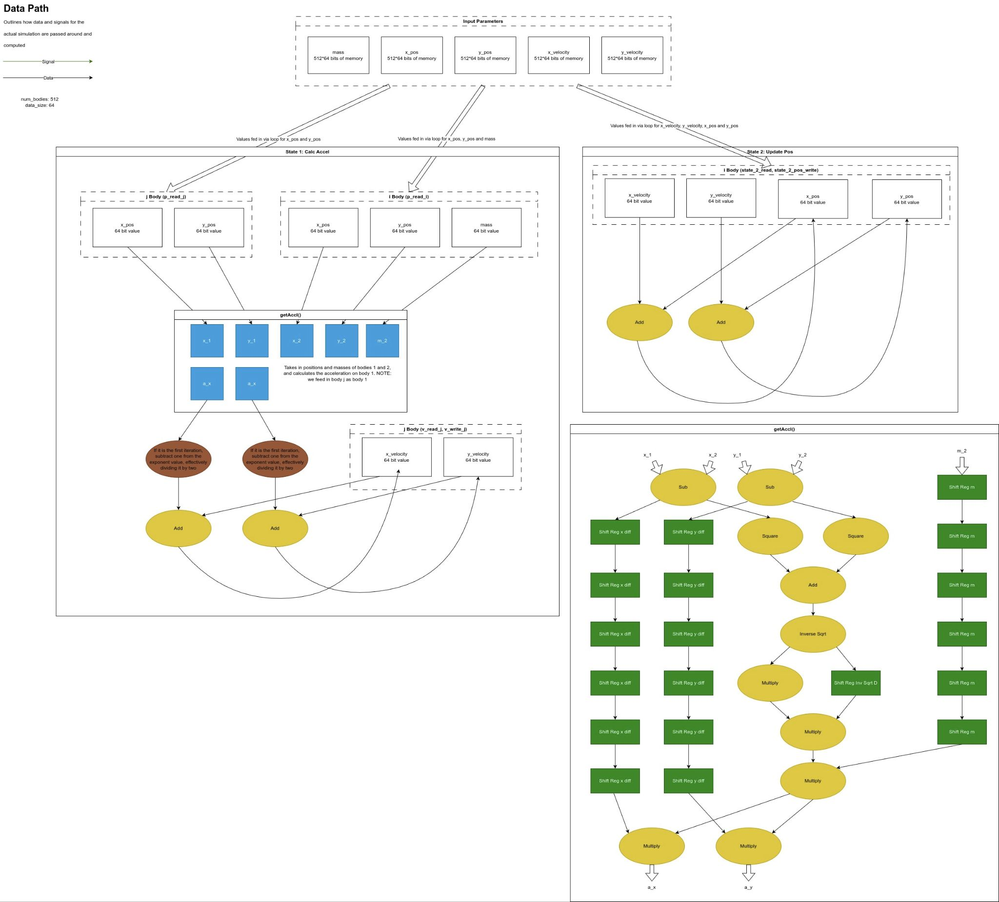

Slide 4
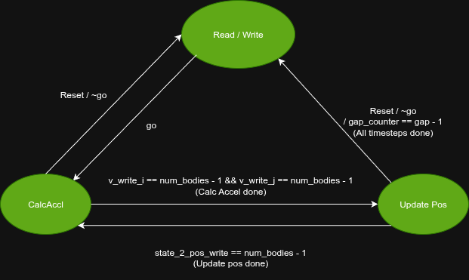
High Level State machine overview

Slide 5
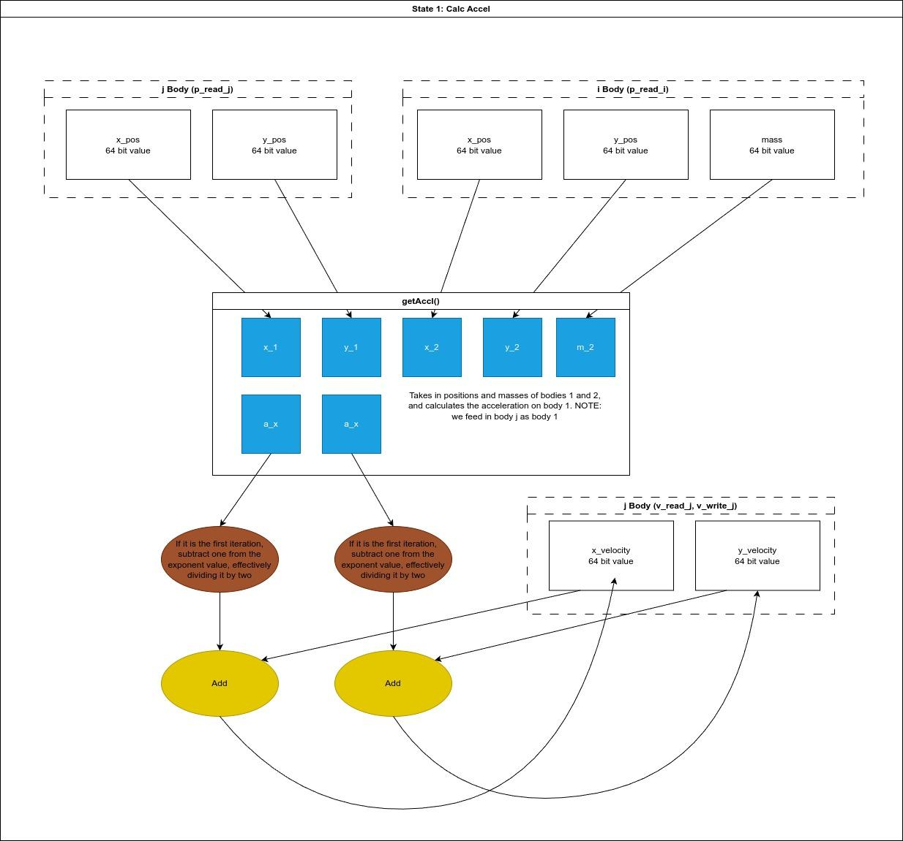
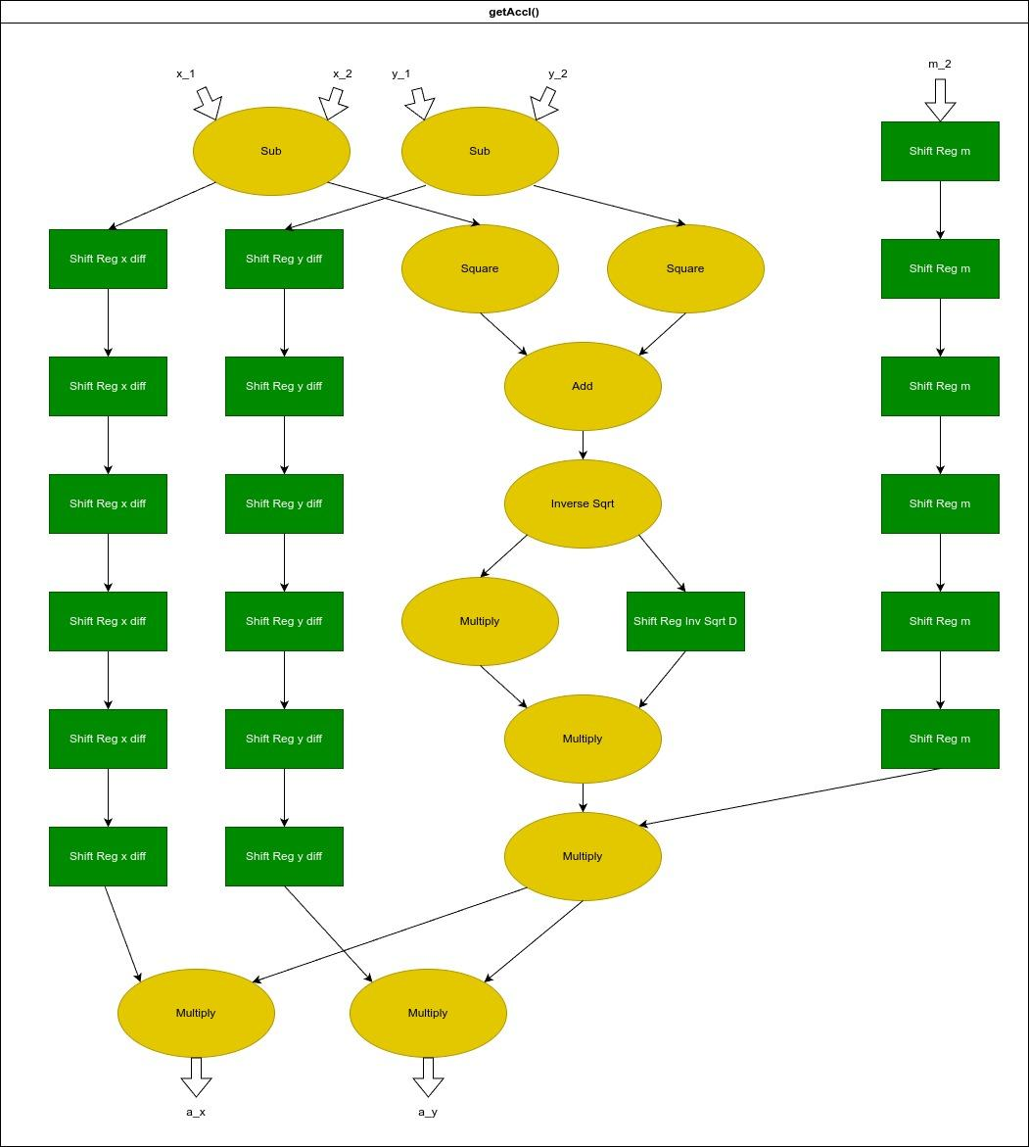
Calculating Acceleration and Velocity

Slide 6
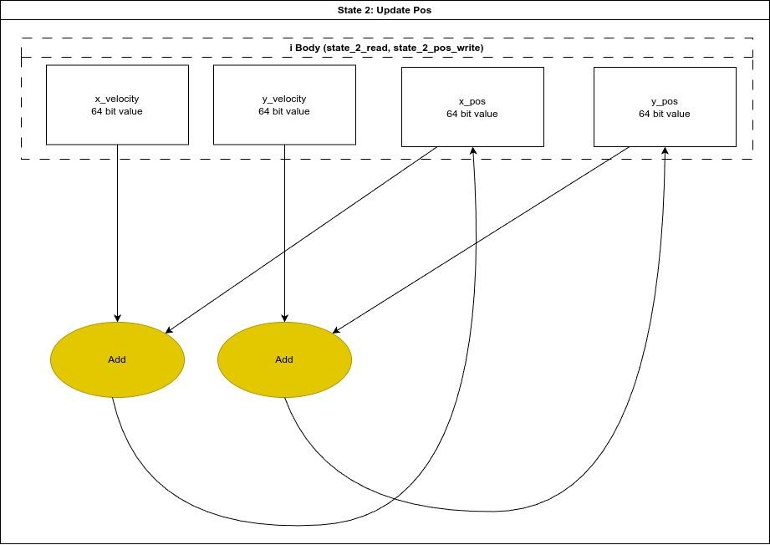
Update Position
Simple loop to add velocity to position.
We are working with timesteps of 1s, thus the velocity can be directly added to position.

Slide 7
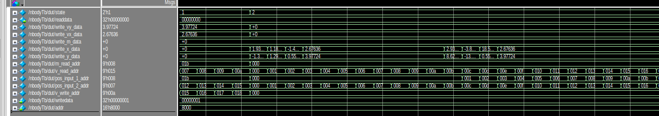
Test bench nightmare
Although we now have similarly complex stack traces, they are limited to sections with errors, and the exact violation is shown, no more hours of adding in extra print statements and scrolling through signals

Slide 8
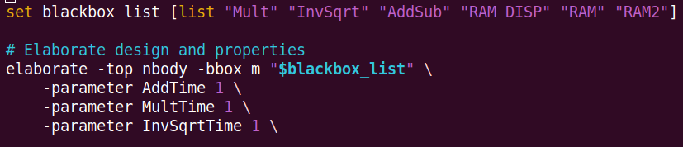
External IP & Params
No point in verifying IP Blocks
Parameters not only significantly reduce runtime, but even prevent JG from blackboxing the shift registers

Slide 9
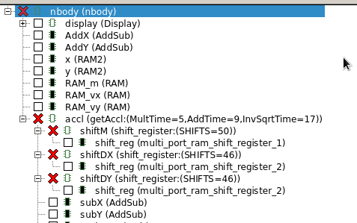
Without parameters to reduce shifter size
JG Automatically black boxes shift registers

Slide 10
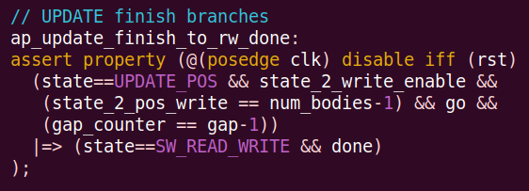
JG Proof Orchestration
An interesting phenomenon is to see an assertion push the limits of bounded model checking (Bm)
After running for 4 minutes, the Proof Orchestration switches the engine to Model Checking (M) and finds a proves the property within 9.2 seconds

Slide 11
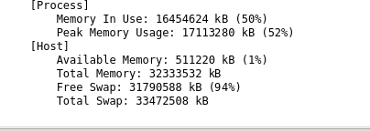
Even more extreme examples and custom
Initially uses Bm engine, and runs for over 14 minutes, using up over 16Gb (!!!) of Memory before deciding to switch to a custom

Slide 12
Assumptions for proper input behavior
Write should only happens under the stage SW_READ_WRITE
configuration parameters num_bodies and gap remain unchanged while the accelerator is running
Whenever the hardware asserts done, the software will eventually issue a read request (read_sw) within 1 to 500 cycles
Read is set high only in the stage SW_READ_WRITE

Slide 13
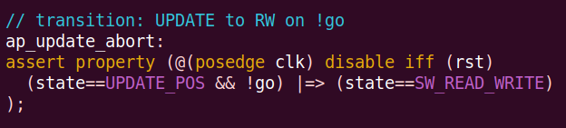
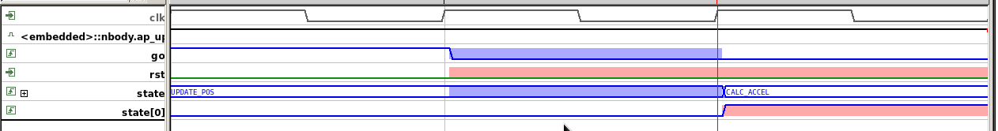
Example Debugging: Abort

Slide 14
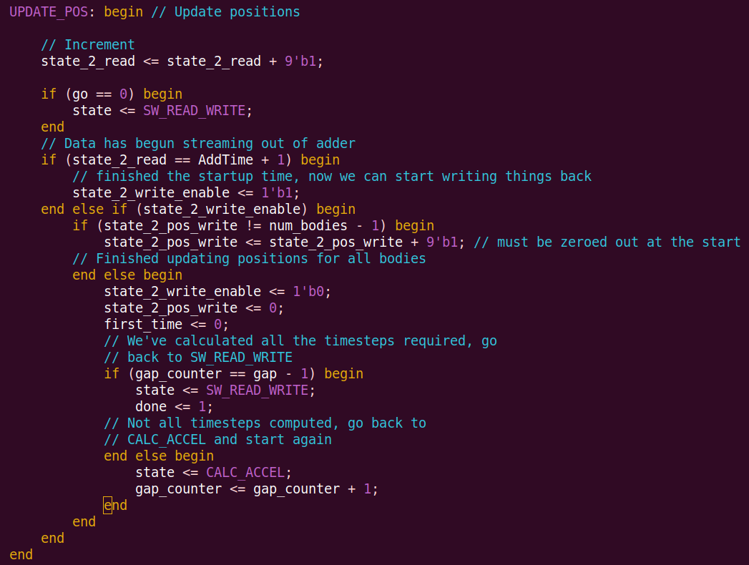
Missing a single else statement here leads to a scenario where go == 0, state is set to SW_READ_WRITE, and in the same clock cycle, we have finished updating positions and go back to calc_accel

Slide 15
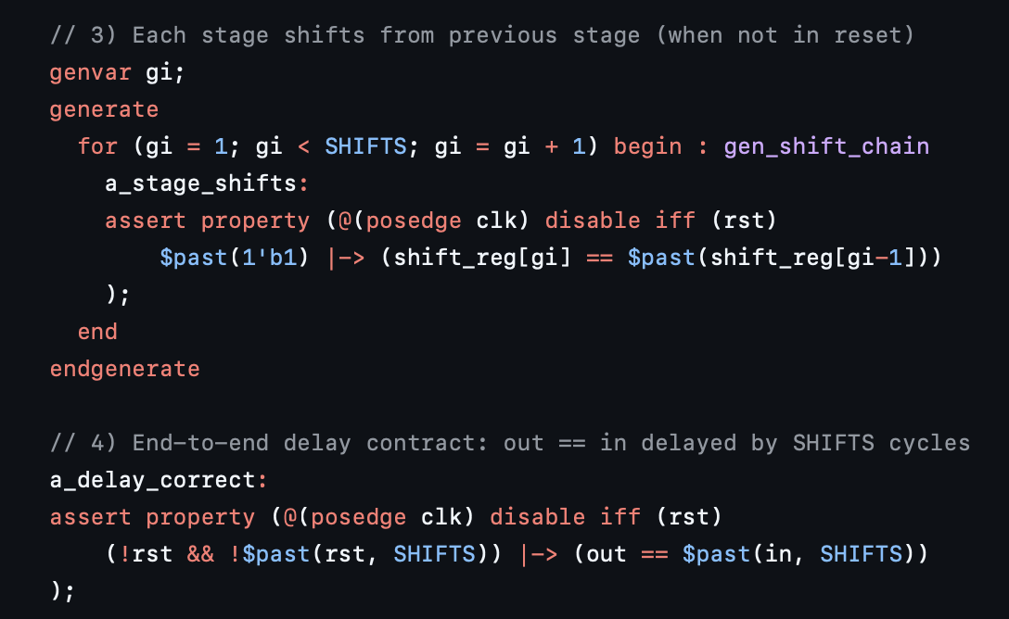
2 key property for shift register
Register-to-register shifting is correct.
The shift register implements the expected delay.

Slide 16
Conclusions & Work to be done
Work can be done on mathematical correctness:
Direct Programming Interface
Jasper Gold C App
Latency checking for pipeline implementation
Using assumption to set delay for the black box, and check the timing for the datapath
Could move towards using specific proof engines

